Slide 1
FMEA - Create the Assessment SAP APM

Slide 2
Presentation content
Step-by-step creation of an FMEA | 4
Bibliography | 10
Reference material for doubts and questions | 10

Slide 3
Prerequisites
Evaluation Type: RPN (Risk Priority Number)
You have the following roles assigned to your user:
FMEAAssessments_Create
FMEAAssessments_Read
FMEAAssessments_Update
FMEAAssessments_Delete
FMEAAssessments_Upload
FMEAAssessments_Publish
FailureData_Read
TechnicalObject_Read
Function_Create
Function_Update
Function_Delete
FunctionalFailure_Create
FunctionalFailure_Update
FunctionalFailure_Delete
RiskCriticalityAssessmentTemplate_Read
Job_Create
Job_Update
Component | Description | Mandatory / Optional | SAP ERP (Type)
Maintainable Item | Item that constitutes a part or an assembly of parts that is normally the lowest level in the equipment hierarchy during maintenance. | Optional | Object Parts (B)
Functions | A statement of what the user of an item (equipment, etc.) wants it to do and to what standard of performance. | Optional
Functional Failures | The termination of the ability of an item (equipment, etc.) to perform a required function. | Optional
Failure Modes | Describes the way in which the inability of an item (such as equipment) to perform a required function occurs. | Mandatory | Coding (D)
Causes | Describes the circumstances during design, manufacture or use which have triggered the failure mechanism and led to the failure (mode). | Mandatory | Causes (5)
Failure Effects | Describes what happens (shows) to the item (equipment, etc.) when a Failure Mode occurs. | Mandatory | Effects (6)
Failure Mechanisms | Describes the physical, chemical, or other processes which have led to the failure (mode). | Optional | Overview of Damage (C)
RPN Evaluation | A numerical assessment of the risk priority level of a failure mode or failure cause in an FMEA analysis. | Mandatory
Recommendation | A mitigation action proposed to eliminate failure​. | Mandatory

Slide 4
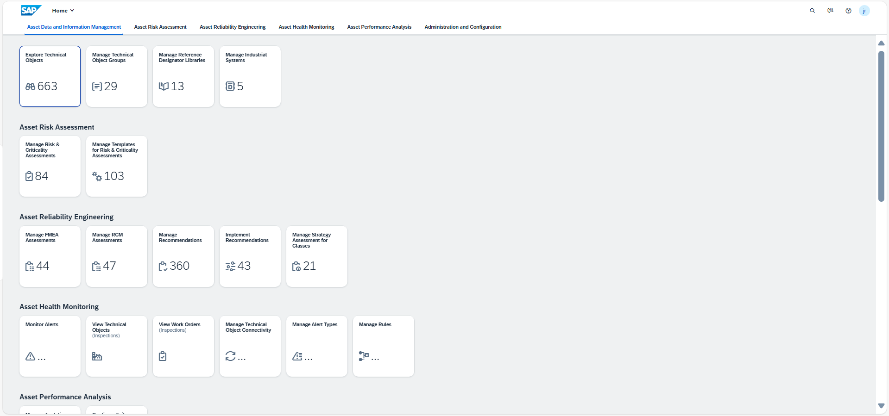
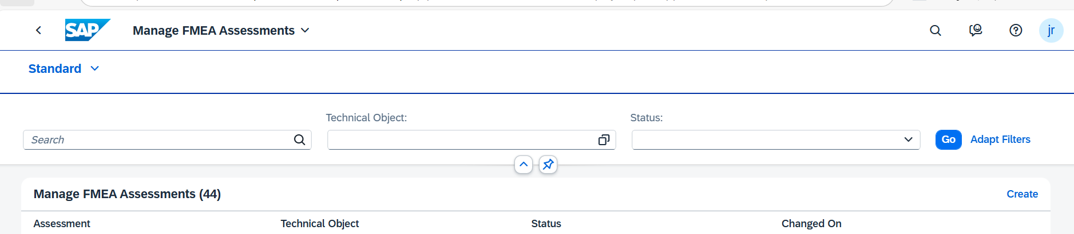
How to Create the Assessment? Step by Step
Create the Assessment:
On the main page of APM, choose the Manage FMEA Assessments tile under the Asset Reliability Engineering tab.
On the Manage FMEA Assessments page, click the Create button to open a pop-up for creating the assessment.
Enter the assessment name, description, and optional long text, choosing the required evaluation type. Evaluation type can either be RPN-based evaluation, Criticality-based evaluation or Both.
Assign a technical object to the assessment by selecting it from the list or using the search bar and filters.
Ensure the failure data profile has at least one failure mode, cause, and failure effect assigned to it.
1
2

Slide 5
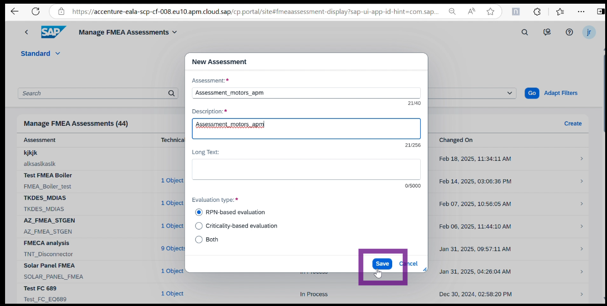
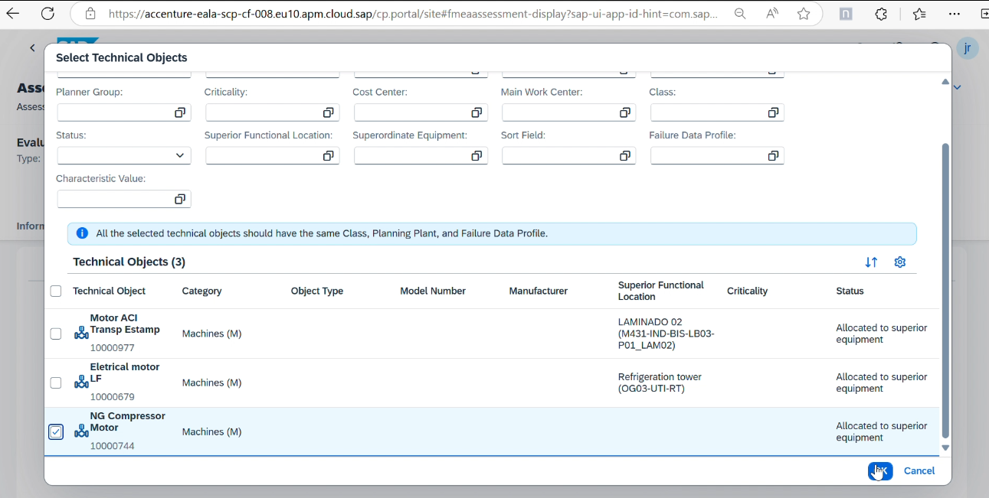
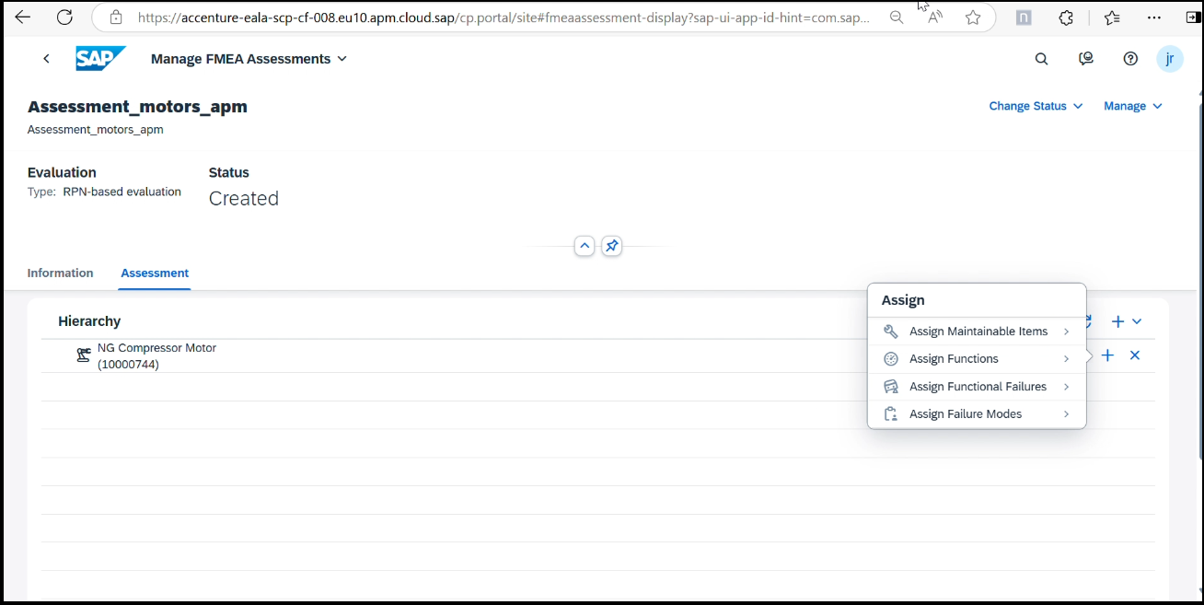

How to Create the Assessment? Step by Step.
4
3
Note
You can create new Functions (Code groups and Codes) and then assign them.
You can create new Functional Failures (Code groups and Codes) and then assign them.
All the failure data for assignment are populated from the failure data profile linked to the technical object(s).
5

Slide 6
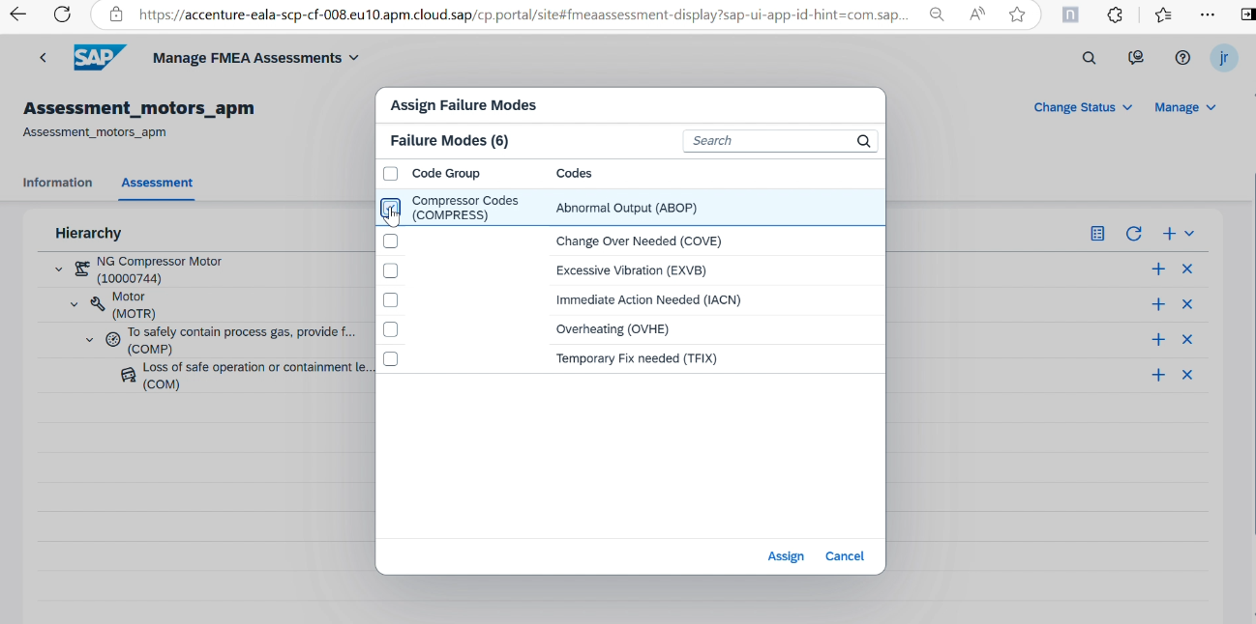
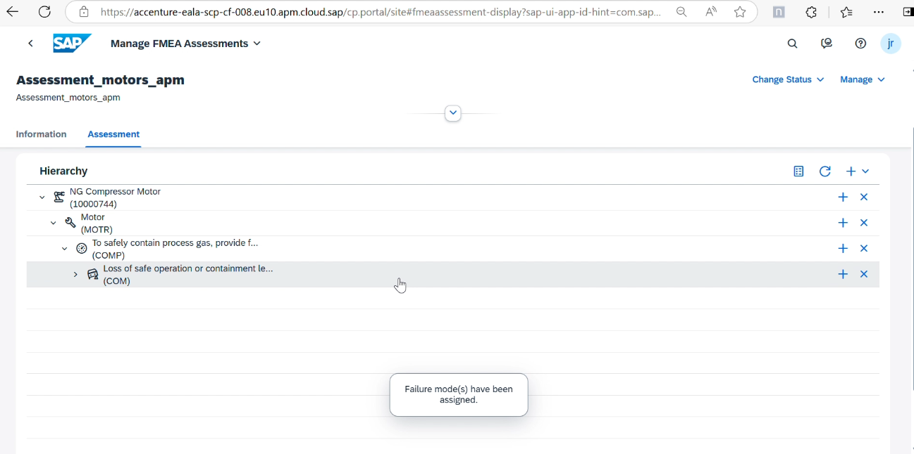
How to Create the Assessment? Step by Step.
Configure the Failure Data:
After creating the assessment, go to the Information tab to view general information.
Switch to the Assessment tab to assign failure data to the FMEA assessment. The required failure data includes failure modes, causes, and effects.
Assign maintainable items, functions, functional failures, and failure modes to the assessment. Create new code groups and codes if necessary.
1
2
3

Slide 7
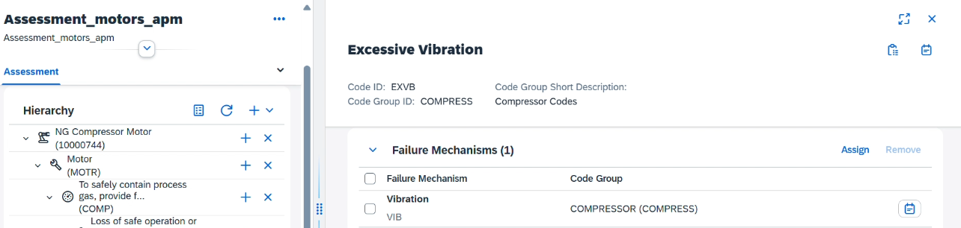
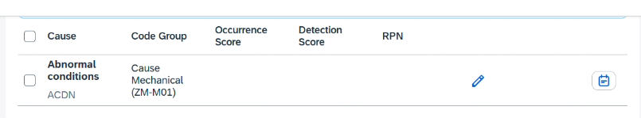
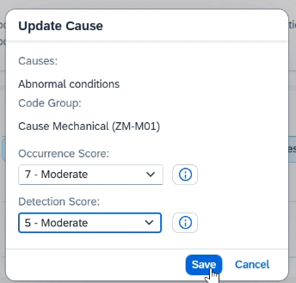
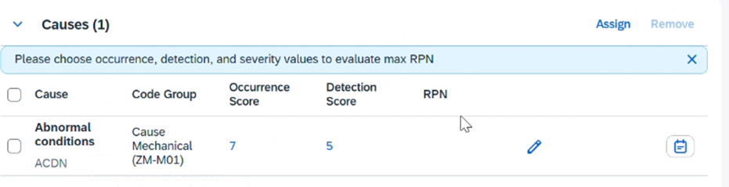
How to Create the Assessment? Step by Step.
Configure RPN Calculation:
Set the severity for the failure mode by selecting it and choosing the severity rating from 1 to 10.
Assign causes to the failure mode and set the occurrence and detection scores for each cause.
1
2

Slide 8
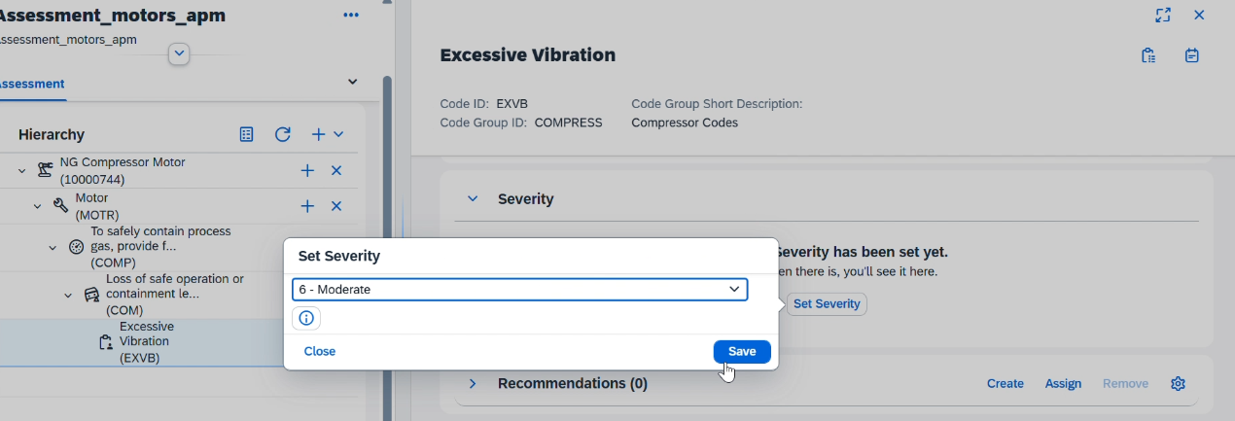
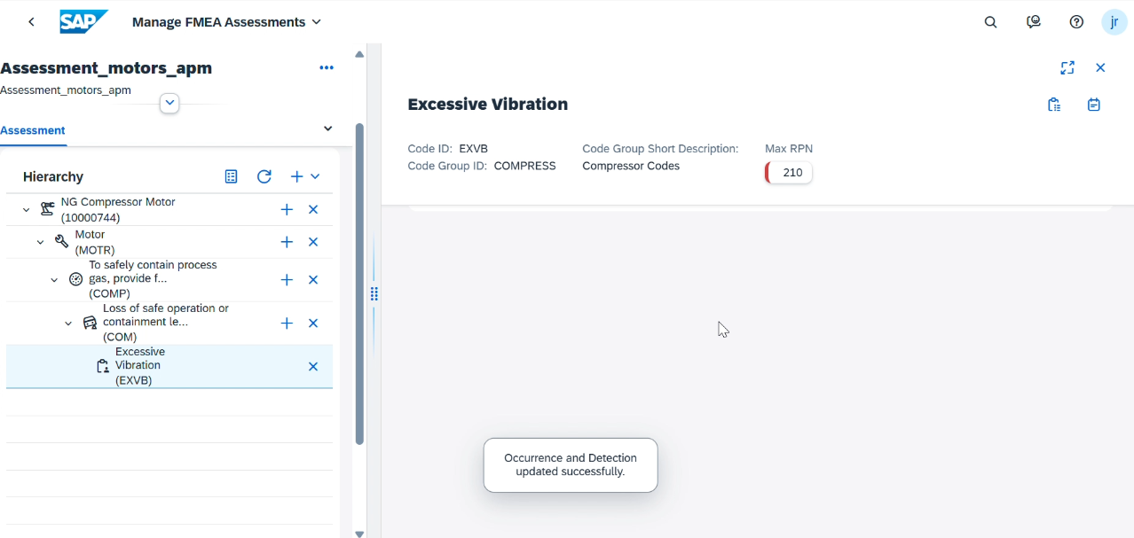
How to Create the Assessment? Step by Step.
The Risk Priority Number (RPN) is calculated by multiplying the severity, occurrence, and detection scores. The highest RPN score will be displayed for the failure mode.
3

Slide 9
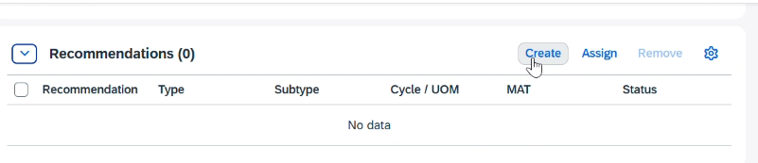
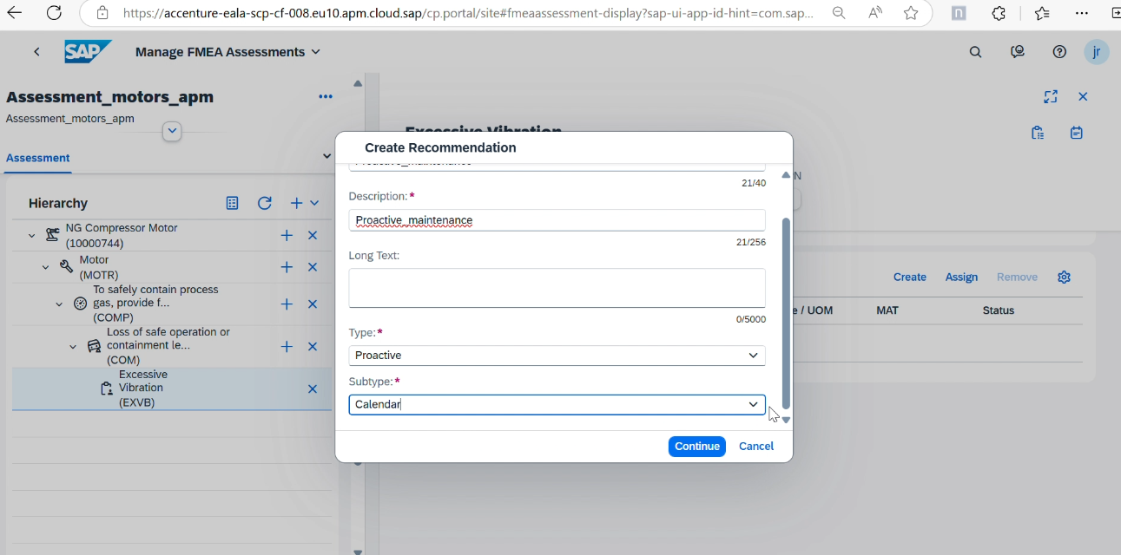
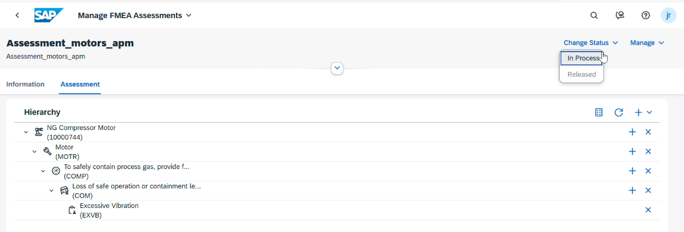
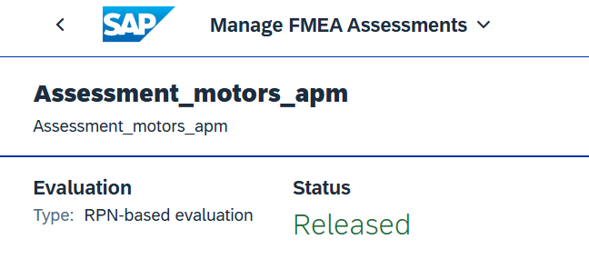
How to Create the Assessment? Step by Step.
Set Up Additional Failure Data and Recommendations:
Assign failure effects and optional failure mechanisms to the failure mode.
Create recommendations to mitigate potential problems based on the failure data. Enter the recommendation name, description, and type, and assign relevant failure data.
Release the Assessment:
Change the assessment status from Created to In Process and then to Released. Once released, the assessment cannot be edited further.
4
5

Slide 10
How to Create the Assessment? Step by Step.
Remember
The risk matrix view will not be available for impacts with more than two dimensions.
Note
All the failure data for assignment are populated from the failure data profile linked to the technical object.
Note
Maximum FMCS value from the set of FMCS values defined for the Recommendations is used as the mitigated FMCS for the Failure Mode.
Status of Recommendation is a criterion to determine the mitigated FMCS. If the status of any Recommendation is set as "Rejected", then its FMCS value is not considered to evaluate mitigated FMCS. All other statuses are to be considered.

Slide 11
Bibliography
Reference material for doubts and questions
https://help.sap.com/docs/SAP_APM/1bb12075258a41e1a024d28a6ddfe246/1b7a9ce1111f49bcb1183c64583a9d7c.html#context
Creating Failure Mode and Performing Effects Analysis
FAQ's.xlsx
Asset Health

